Slide 1

(IF216007)
Mengenal, Menyiapkan, dan Memvisualisasikan Data (terstruktur dan tidak terstruktur)
oleh:
Wildan Budiawan Zulfikar, ST., M.Kom
Dian Sa’adillah Maylawati, S.Kom., MT
JURUSAN INFORMATIKA
FAKULTAS SAINS DAN TEKNOLOGI
UIN SUNAN GUNUNG DJATI BANDUNG
2022

Slide 2
Indikator Ketercapaian
Outcome Mata Kuliah
Outcome Program Studi
CLO-1: Mahasiswa mampu menjelaskan konsep pembelajaran mesin dan mengidentifikasi kebutuhan data dalam konsep pembelajaran mesin
PLO-02: Mampu menyelesaikan permasalahan dengan formulasi solusi efisien berbasis prinsip - prinsip komputasi
PLO-04: Memiliki pengetahuan dan pemahaman yang komprehensif pada area yang spesifik di bidang informatika
Outcome Perkuliahan
Mahasiswa dapat mengidentifikasi kebutuhan dalam mengenali, menyiapkan, dan memvisualisasikan data

Slide 3
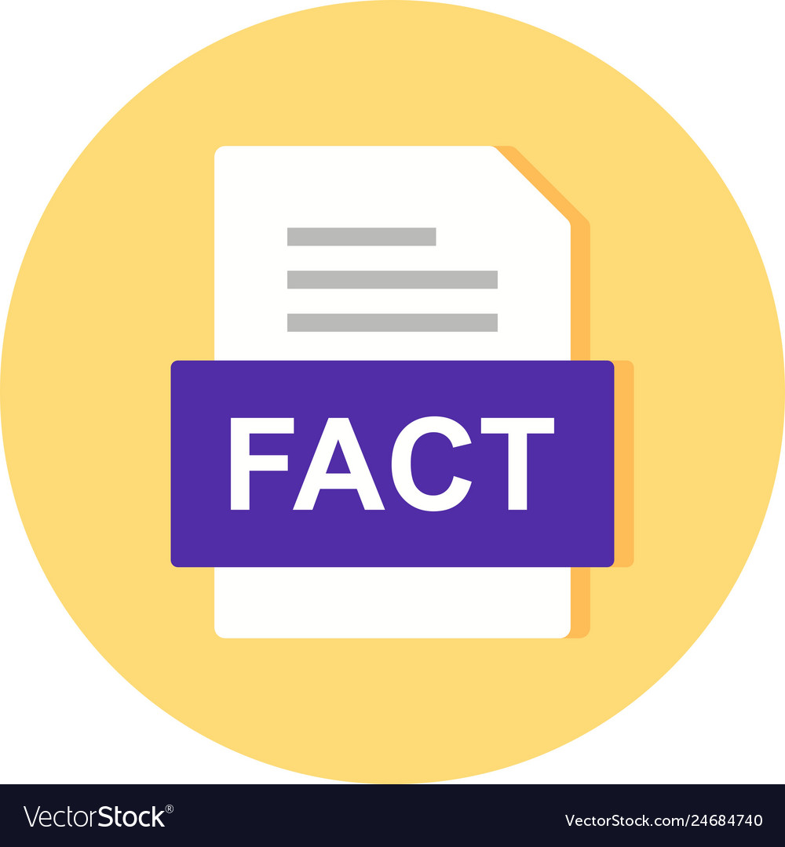



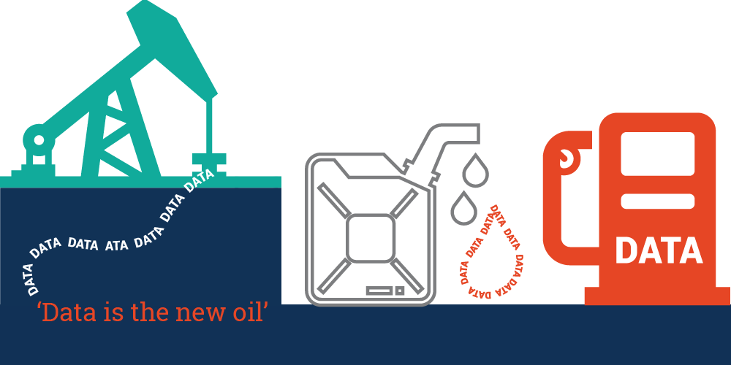
Data?
Facts
Observations
Measurements
Statistics
Data is the new Oil. Data is just like crude. It is valuable, but if unrefined it cannot really be used – Clive Humby, Dunn Humby

Slide 4
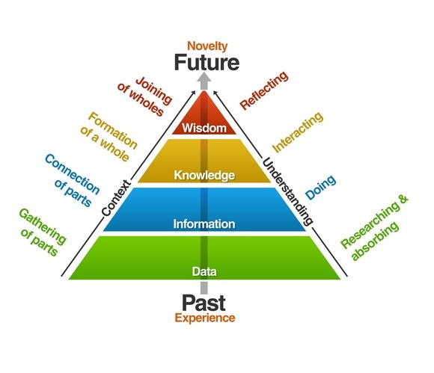
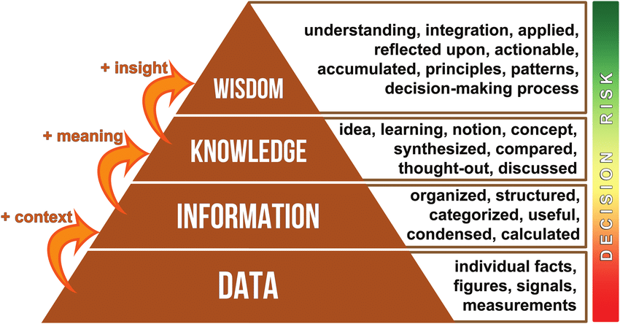
Data to Wisdom

Slide 5
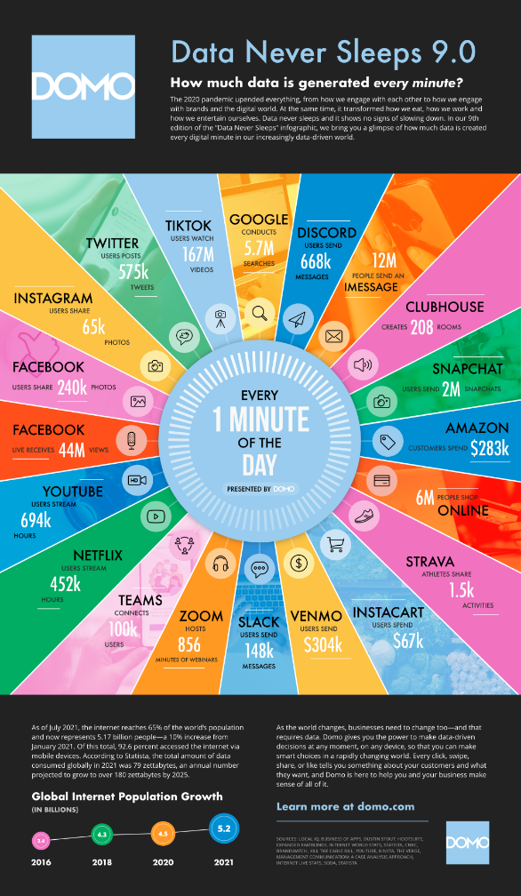
Data Today
https://www.domo.com/learn/infographic/data-never-sleeps-9

Slide 6
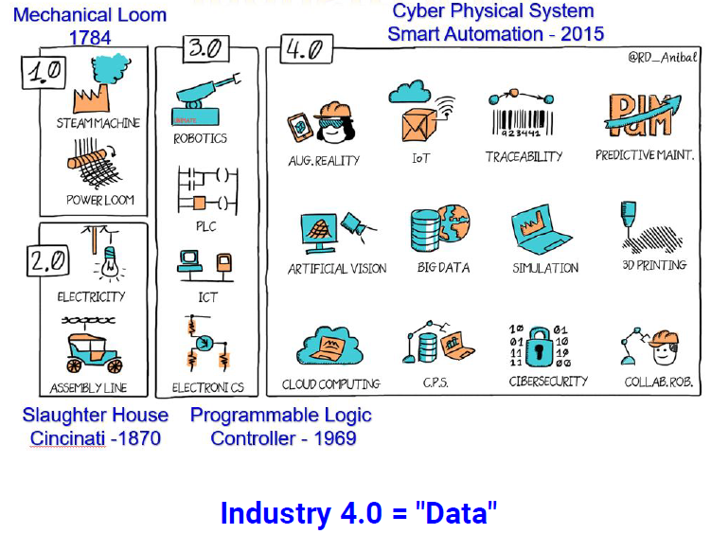
Data Today

Slide 7
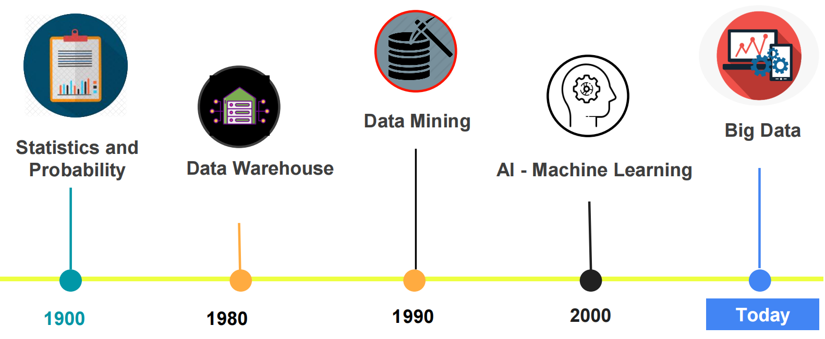
Big Data

Slide 8
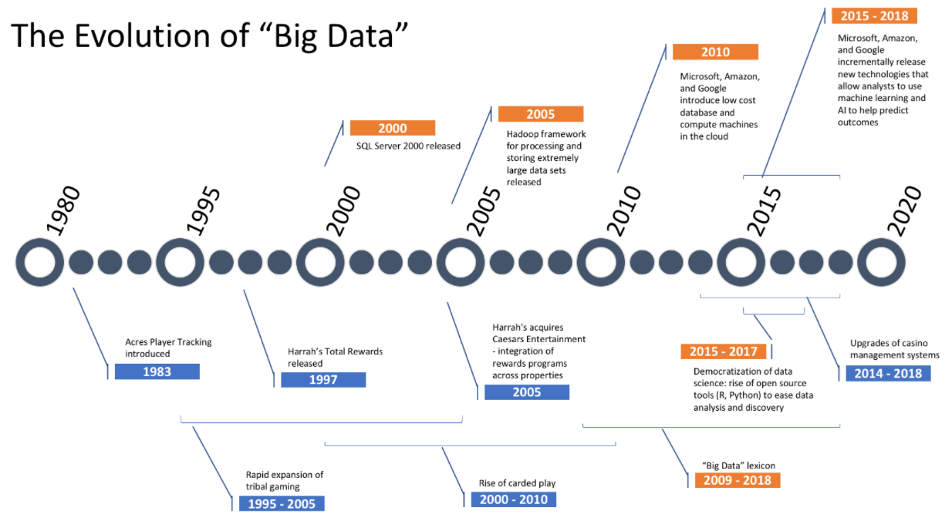
Big Data
https://betravingknows.com/weekly-reports/data-analytics/2018/05/how-big-data-shaped-todays-casino-and-why-you-should-care/

Slide 9
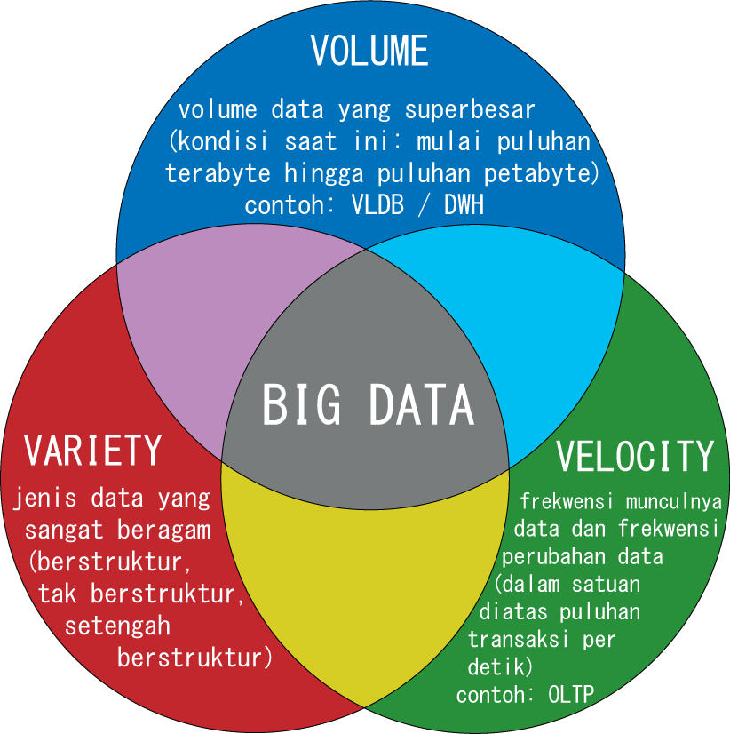
Big Data
Exteremely large data sets that may be analyzed computationally to reveal patterns, trends, and associations, especially relating to human behavior and interactions. The term is often used synonymously with related concept such as Business Intelligence (BI), data mining, data science.

Slide 10
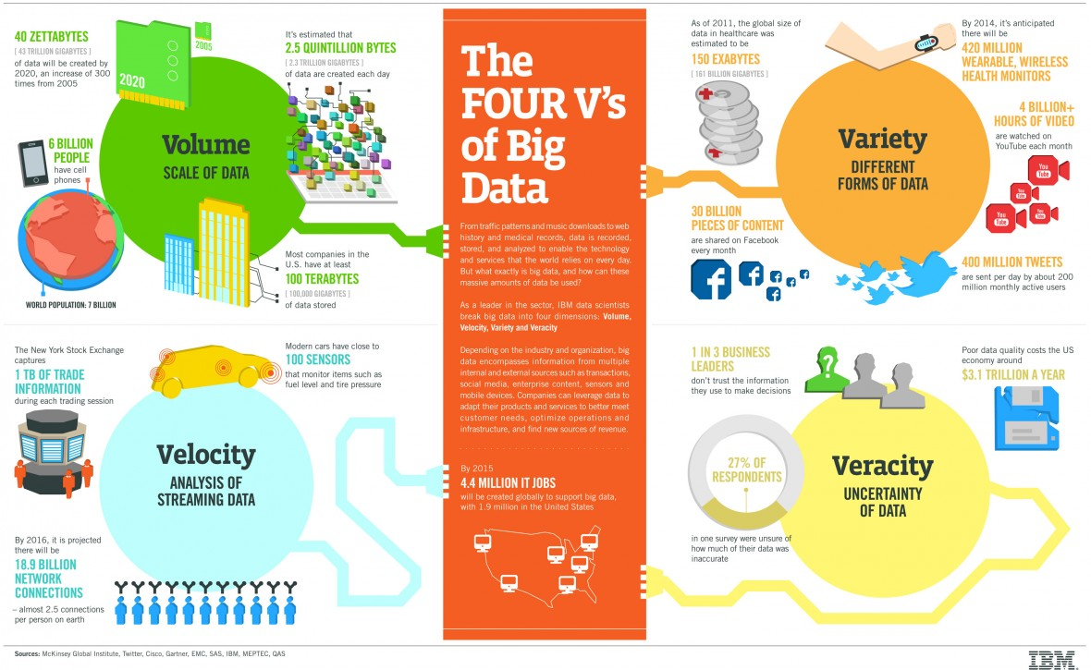
Big Data

Slide 11
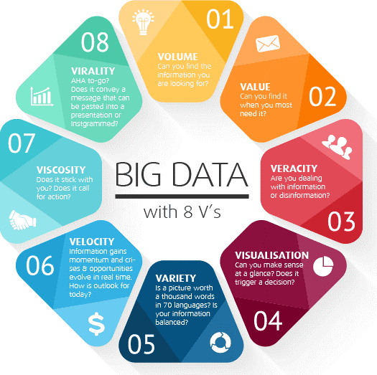
Big Data

Slide 12
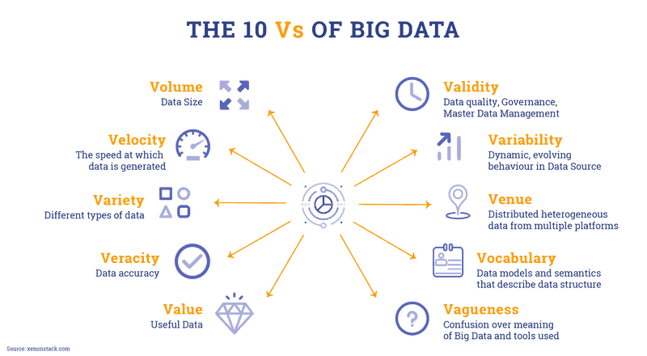
Big Data

Slide 13
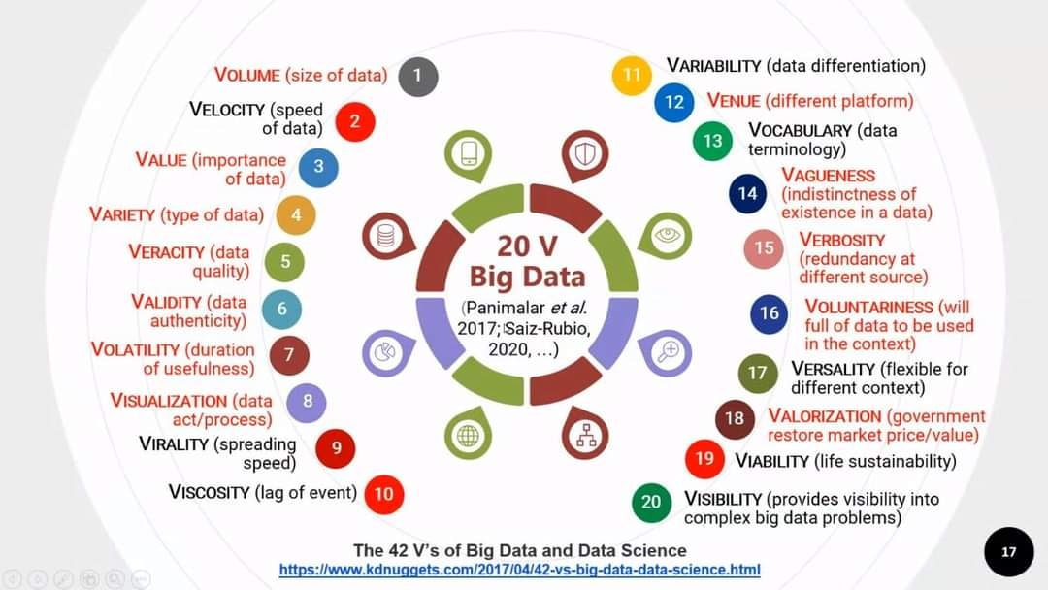
Big Data

Slide 14
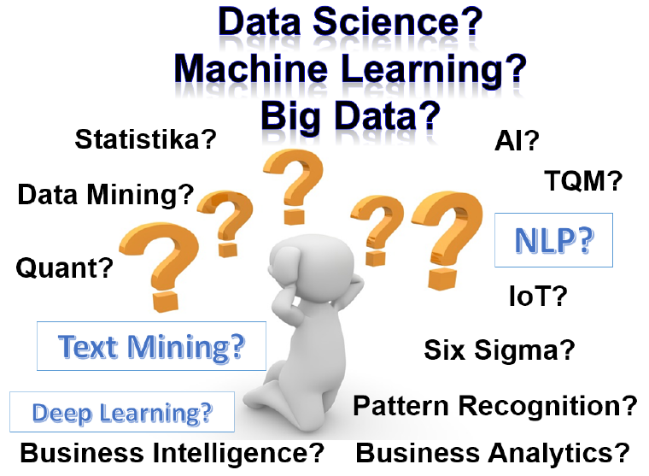
SO?

Slide 15
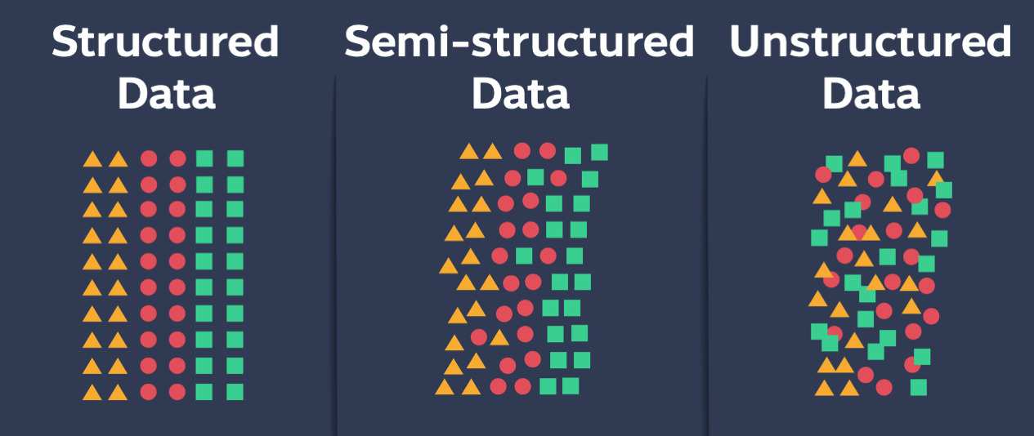
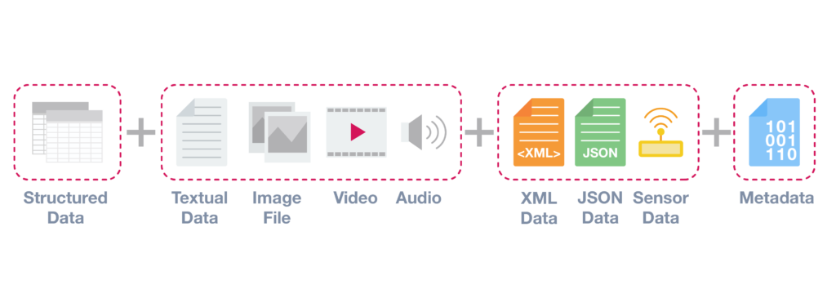
Data Type

Slide 16
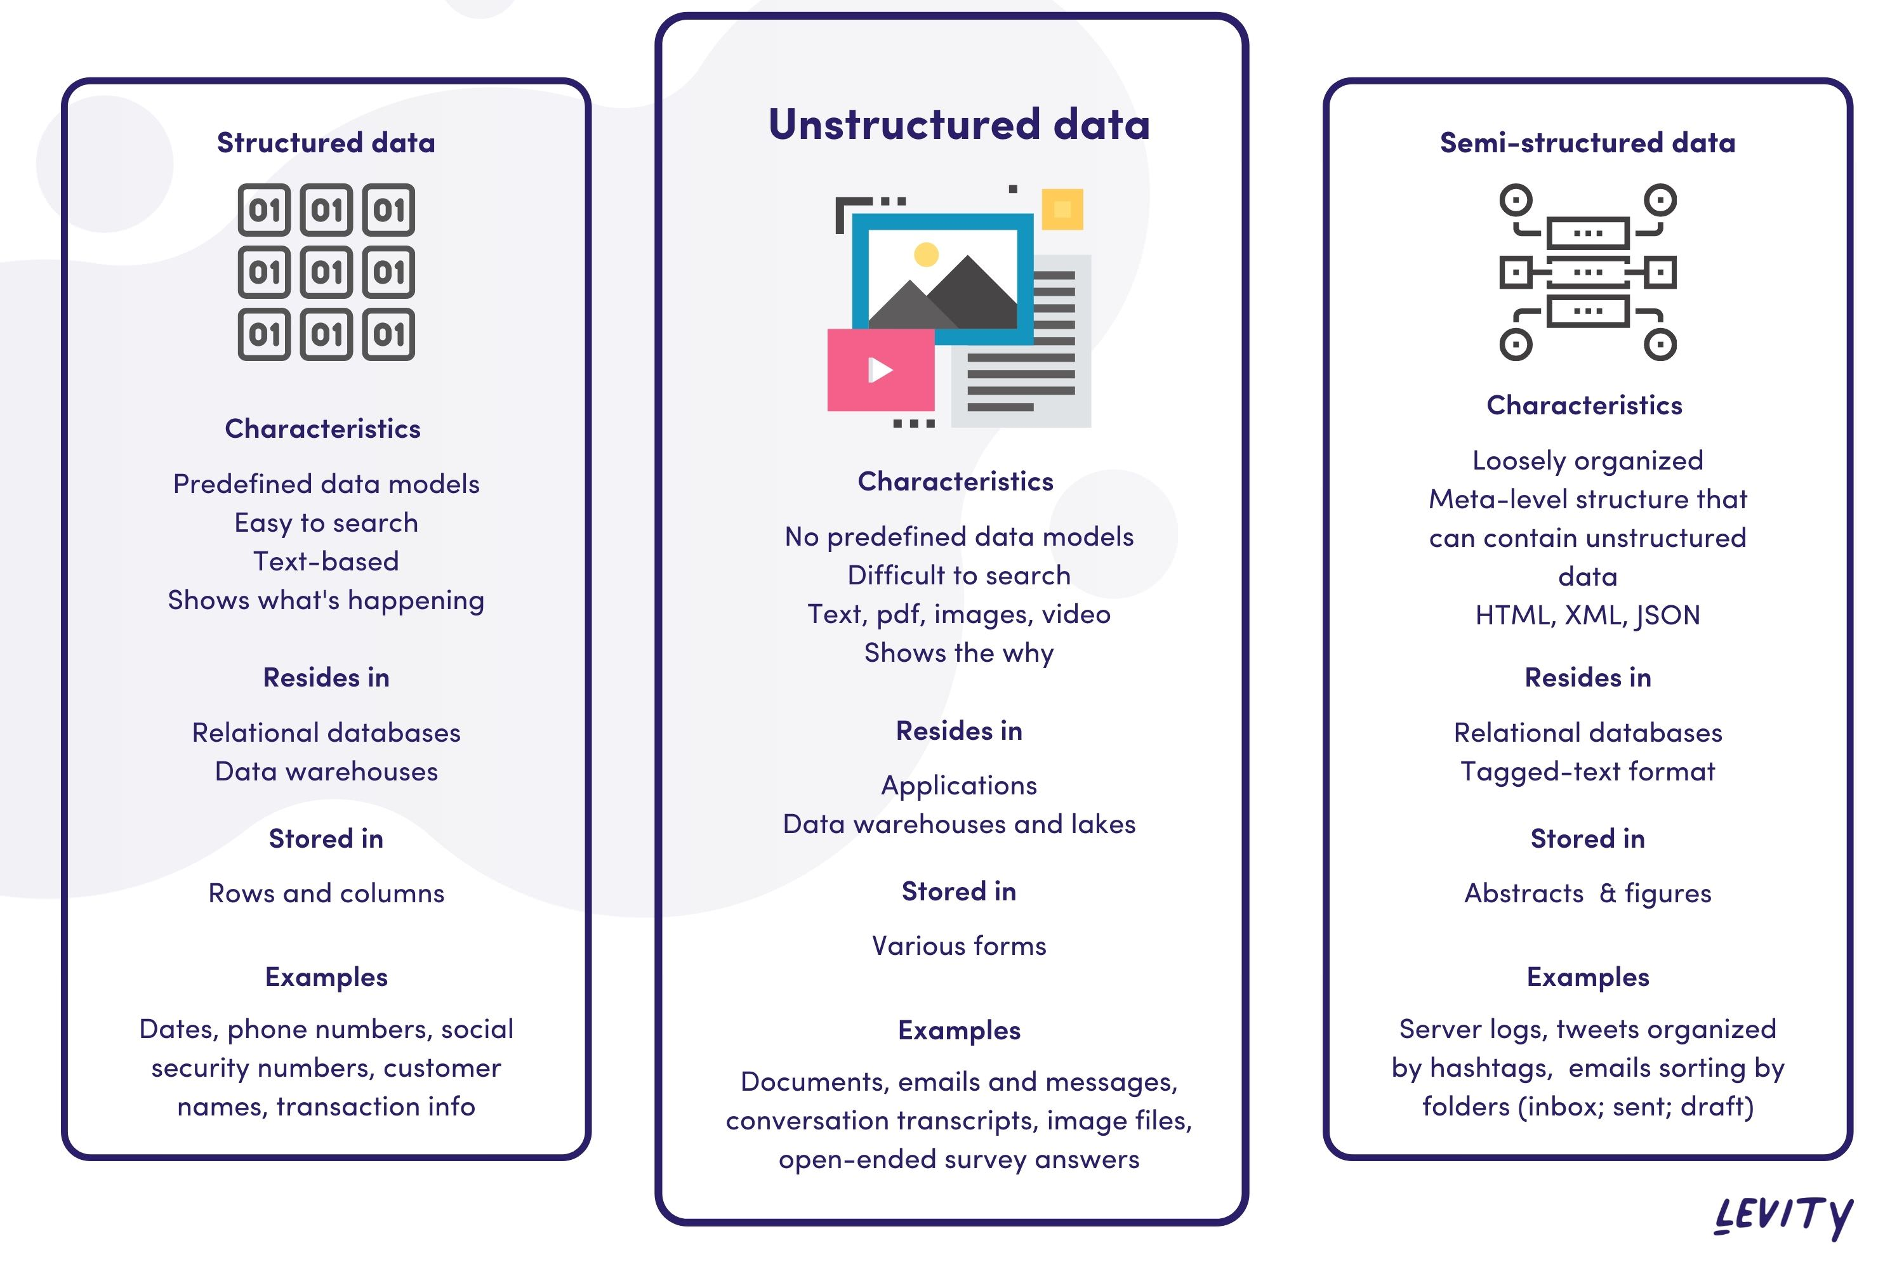
Data Type

Slide 17
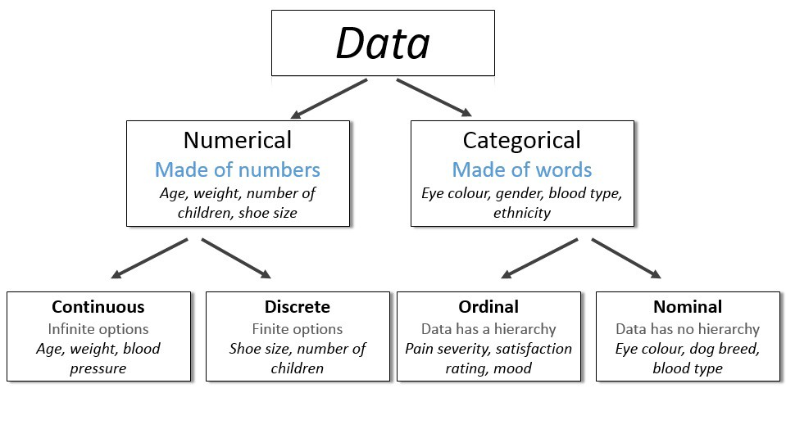
Structured Data Type

Slide 18
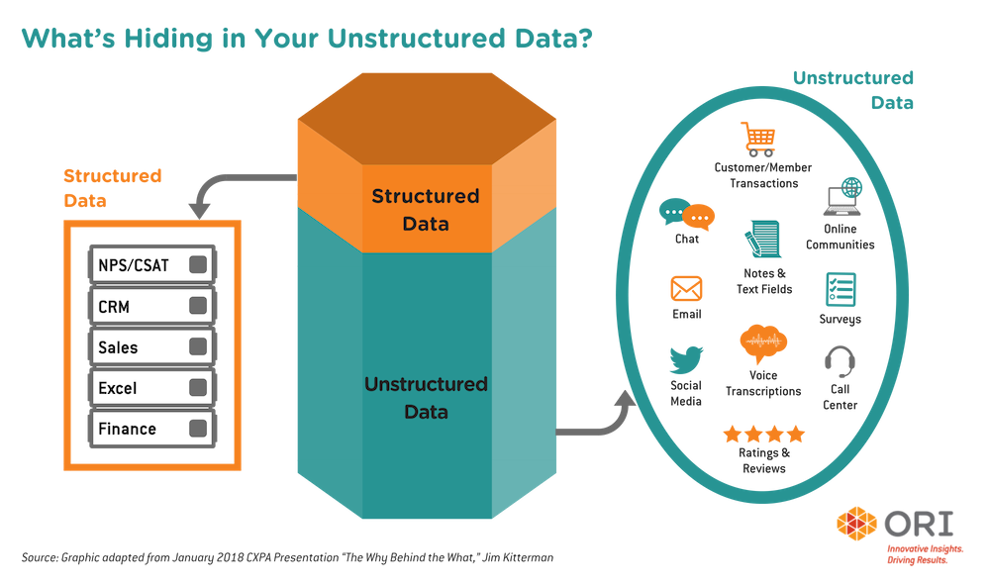
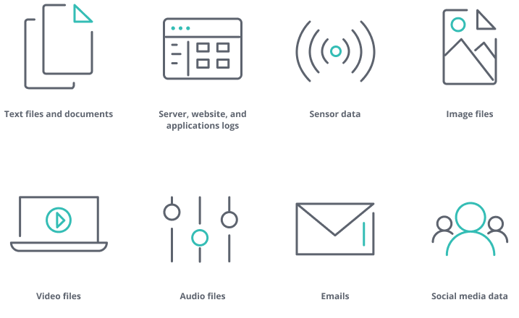
Unstructured Data Type

Slide 19

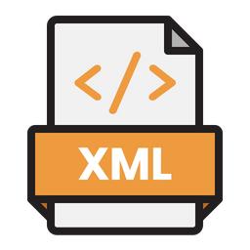
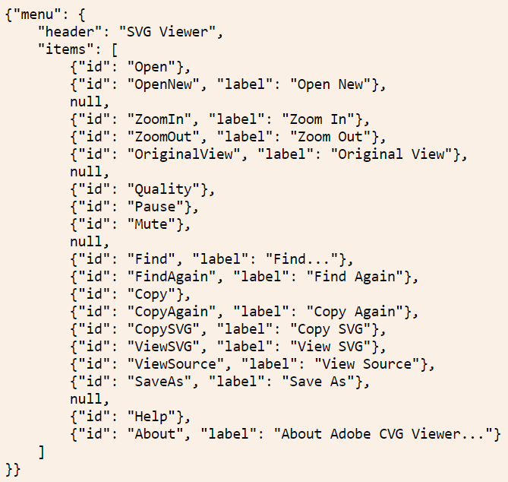
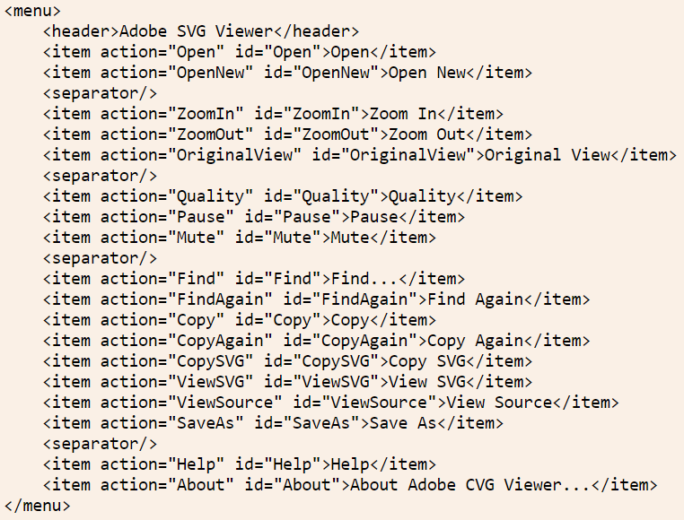
Semi-structured Data

Slide 20
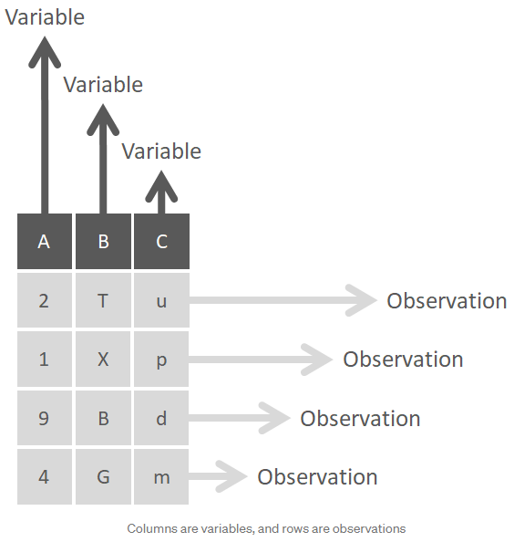
Structured Data Preparation
Gathering/ Collecting Data
The data preparation process begins with finding the right data.
Discover & Assess Data
This step is about getting to know the data and understanding what has to be done before the data becomes useful in a particular context.
Cleanse & Validate Data
Cleaning up the data is traditionally the most time consuming part of the data preparation process, but it’s crucial for removing faulty data and filling in gaps.
Removing extraneous data and outliers.
Filling in missing values.
Conforming data to a standardized pattern.
Masking private or sensitive data entries.
Transform & Enrich Data
Transforming data is the process of updating the format or value entries in order to reach a well-defined outcome, or to make the data more easily understood by a wider audience. Enriching data refers to adding and connecting data with other related information to provide deeper insights.
Store Data
Once prepared, the data can be stored or channeled into a third party application—such as a business intelligence tool—clearing the way for processing and analysis to take place.
https://www.talend.com/resources/what-is-data-preparation/
https://towardsdatascience.com/the-basics-of-data-prep-7bb5f3af77ac

Slide 21
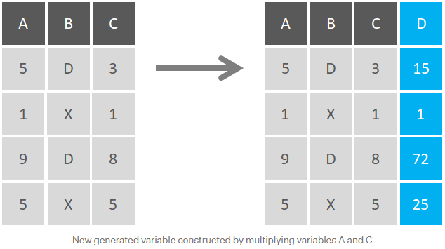
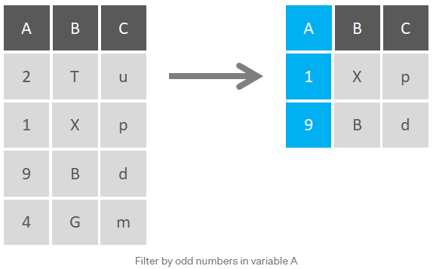
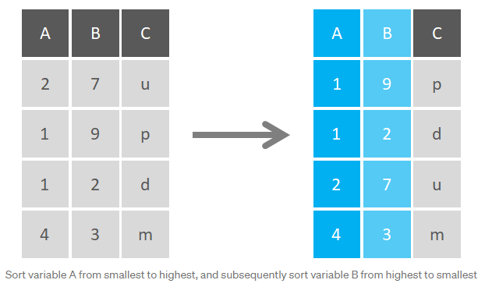
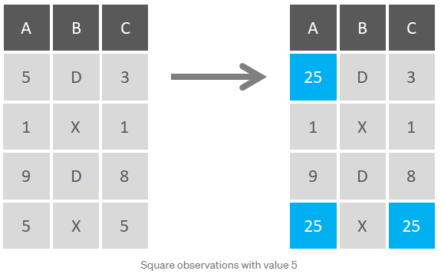
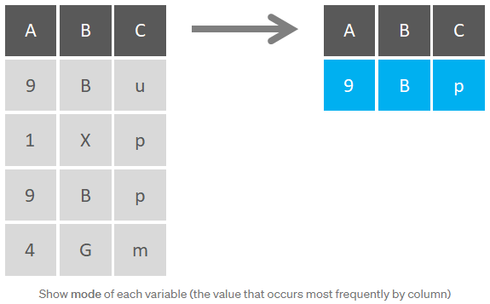
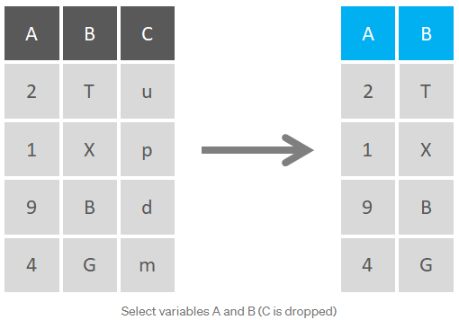
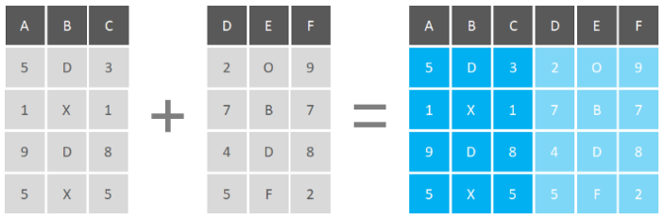
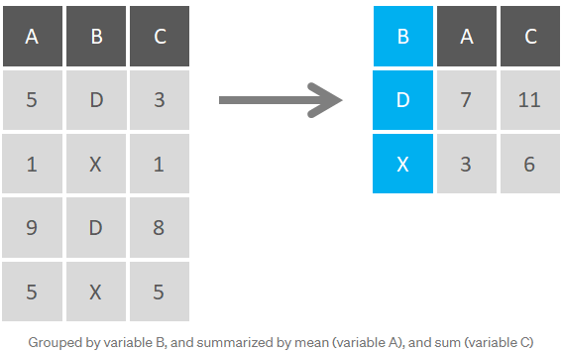
Structured Data Preparation

Slide 22
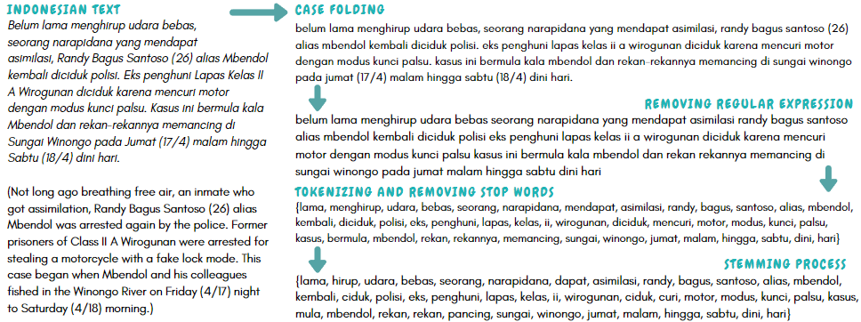
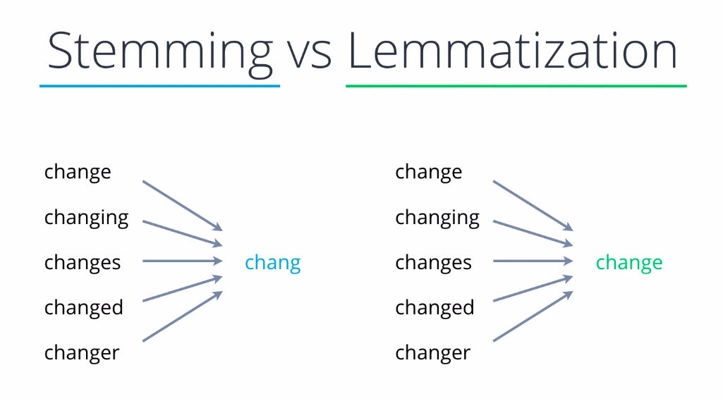
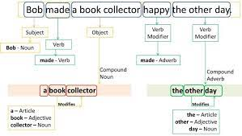
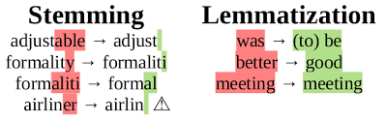
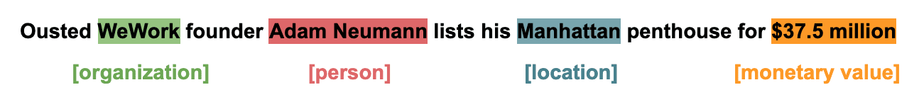
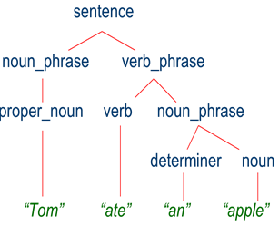
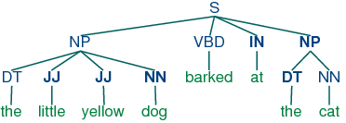
Unstructured Data Preparation (Text)
Lower-case/ Normalize
Tokenize
Part-of-speech tagging
Change abbreviation
Remove Stop words
Stemming
Lemmatization
Remove regular expression
Chunking
Parsing
Name entity recognition

Slide 23
Semi-structured Data Preparation
Semi-structured data have different structure because of heterogeneity of the sources. Sometimes they do not contain any structure at all. This makes it difficult to tag and index. So while extract information from them is tough job. Here are possible solutions –
Graph based models (e.g OEM) can be used to index semi-structured data
Data modelling technique in OEM allows the data to be stored in graph based model. The data in graph based model is easier to search and index.
XML or JSON allows data to be arranged in hierarchical order which enables the data to be indexed and searched
Use of various data mining tools

Slide 24
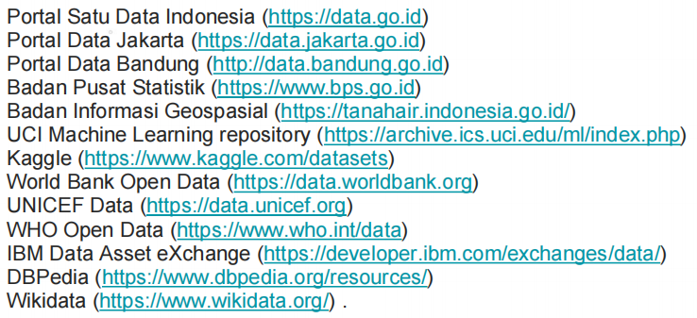
Sumber Data

Slide 25
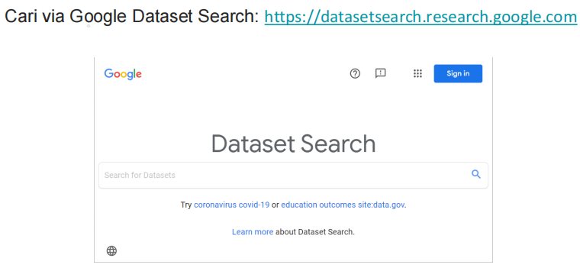
Sumber Data

Slide 26
Tugas Mandiri
Pahami dan jelaskan persiapan data (pre-processing data) untuk jenis data tidak terstruktur Gambar, Video, dan Audio/ Rekaman Suara!
Tugas dikumpulkan maksimal 1 minggu setelah materi ini disampaikan.

Slide 27
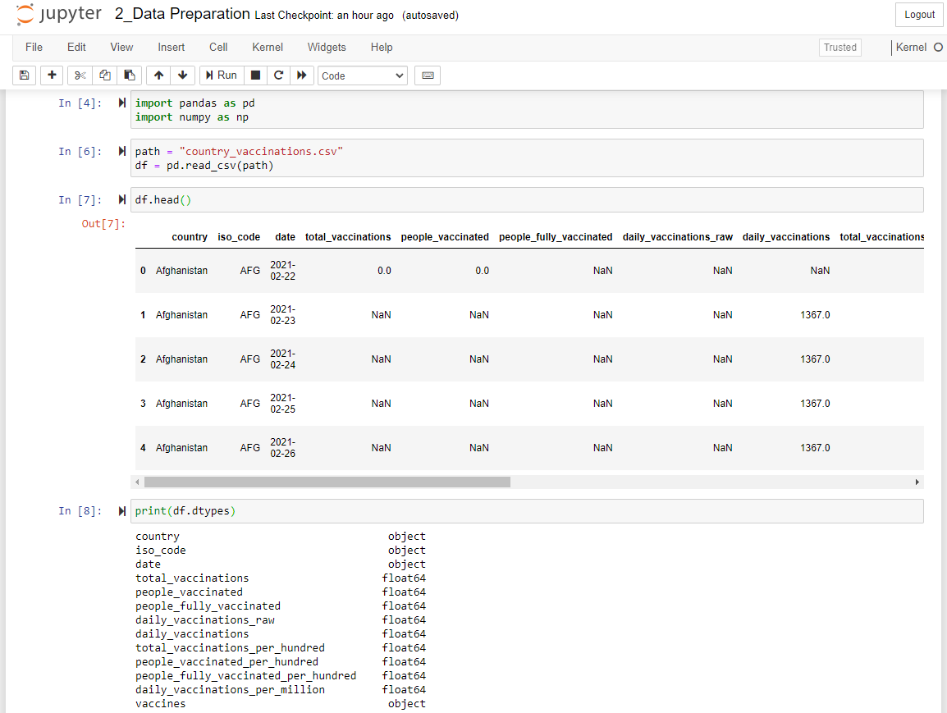

Praktikum

Slide 28
Tugas Praktikum
Silahkan unduh data baik di Kaggle ataupun sumber lainnya dengan jenis data terstruktur, semi-terstruktur, dan tidak terstruktur.
Lakukan penelaahan data seperti yang dicontohkan pada praktikum!
Tugas dikumpulkan maksimal 1 minggu setelah materi ini disampaikan.

Slide 29

Referensi
1. Donald Hearn, M. Pauline Baker. Computer Graphics C Version. Prentice-Hall. 1997 (Pustaka Utama)
2. Max K. Agoston. Computer Graphics and Geometric Modeling : Implementation and Algorithms. Springer (Pustaka Pendukung)
3. Edhi Nugroho. Grafika Komputer (Teori dan Praktek) menggunakan Delphi dan OpenGL (Pustaka Pendukung)
4. Achmad Basuki & Nana Ramadijanti. 2016. Grafika Komputer –Teori Dan Implementasi, Penerbit ANDI: Yogyakarta (Pustaka Pendukung)
5. Pulung Nurtantio Andono & T. Sutoyo. Konsep Grafika Komputer, Penerbit ANDI: Yogyakarta (Pustaka Pendukung)
6. www.opengl.org (Pustaka Utama)
7. https://www.microsoft.com/en-us/download/search.aspx?q=directx (Pustaka Pendukung)8.https://unity3d.com/ (Pustaka Pendukung)
8. Edward Angel, Interactive Computer Graphics: A Top-Down Approach with OpenGL 2nd, Addison Wesley, 2005.
9. John F. Hughes, Andries Van Dam, Morgan Mcguire, David F. Sklar, James D. Foley, Steven K. Feiner, Kurt Akeley, Computer Graphics: Principles and Practice (3 rd edition), Addison-Wesley, 2014

